Slide 1



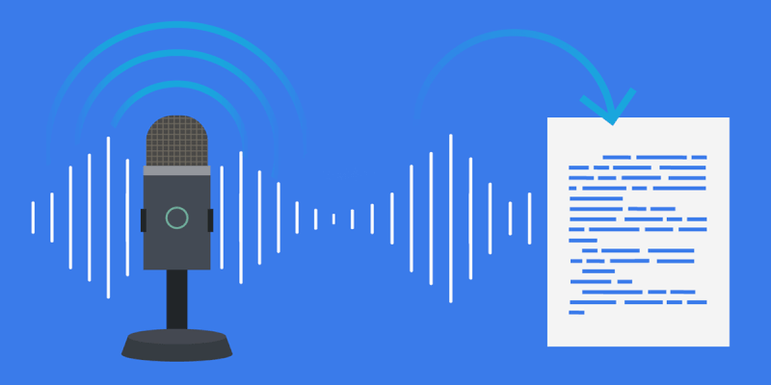
Speech Recognition using Python
Python packages: Installation
pip install SpeechRecognition --> for speech recognition
pip install PyAudio --> for microphone access

Slide 2
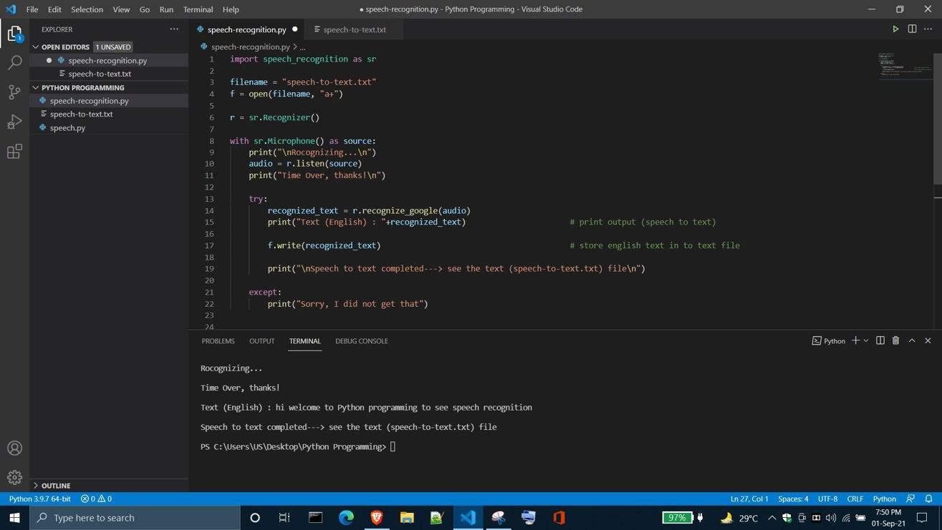

Slide 3
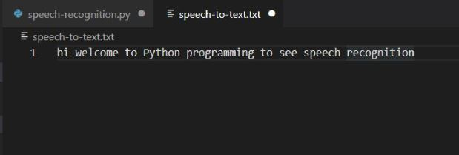
Text file: (speech-to-text.txt)

